Slide 1

Explainable Artificial Intelligence (XAI)
FY17
FY18
FY19
FY20
FY21
David Gunning
DARPA/I2O

Slide 2
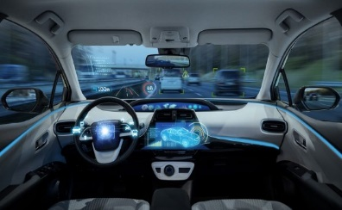

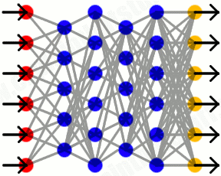

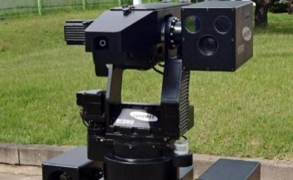



The Need for Explainable AI
AI System
User
http://listverse.com/
©2007–2017 Listverse Ltd
https://www.re-work.co/
© 2017 RE-WORK X LTD
Transportation
Finance
http://explainthatstuff.com
We are entering a new age of AI applications
Machine learning is the core technology
Machine learning models are opaque, non-intuitive, and difficult for people to understand
Why did you do that?
Why not something else?
When do you succeed?
When do you fail?
When can I trust you?
How do I correct an error?
http://listverse.com/
©2007–2017 Listverse Ltd
http://www.bbc.com/
© 2017 BBC
Credit: Getty Images
Security
Legal
http://blog.soliant.com/
©2004-2017 Soliant Health
https://futureoflife.org/
©FLI - Future of Life Institute
Medicine
Military
The current generation of AI systems offer tremendous benefits, but their effectiveness will be limited by the machine’s inability to explain its decisions and actions to users
Explainable AI will be essential if users are to understand, appropriately trust, and effectively manage this incoming generation of artificially intelligent partners

Slide 3
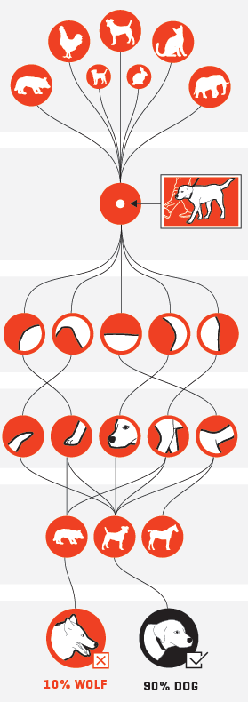

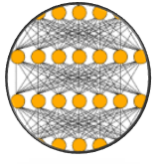



Deep Learning Neural Networks Architecture and How They Work
Deep Learning Neural Network
Training Data
Input
(unlabeled image)
Low-level features to high-level features
Neurons respond to simple shapes
1st Layer
Neurons respond to more complex structures
2nd Layer
Neurons respond to highly complex, abstract concepts
n^{th} Layer
Automatic algorithm
(feature extraction and classification)
https://www.xenonstack.com/
XenonStack ©
http://fortune.com/
© 2018 Time Inc.

Slide 4

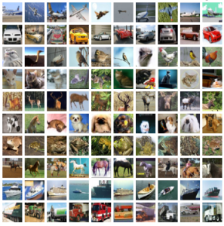
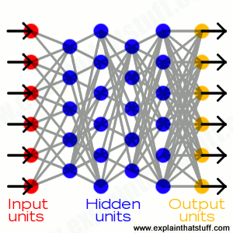
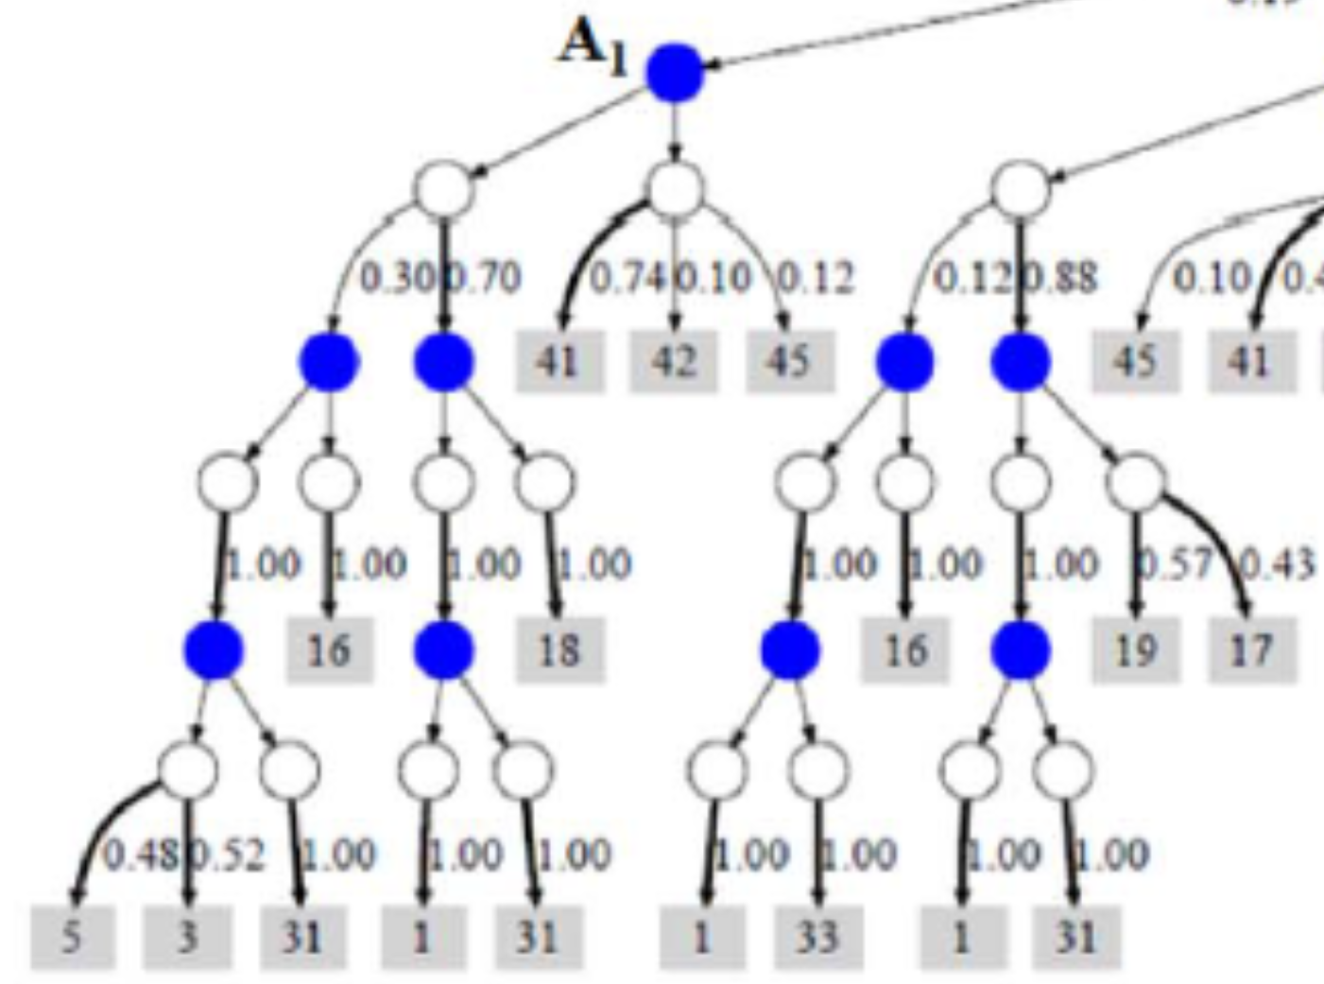



What Are We Trying To Do?
Today
©Spin South West
Why did you do that?
Why not something else?
When do you succeed?
When do you fail?
When can I trust you?
How do I correct an error?
Learning
Process
This is a cat
(p = .93)
©University Of Toronto
http://explainthatstuff.com
Training
Data
Learned
Function
Output
User with
a Task
Tomorrow
©Spin South West
I understand why
I understand why not
I know when you’ll succeed
I know when you’ll fail
I know when to trust you
I know why you erred
New
Learning
Process
This is a cat:
It has fur, whiskers, and claws.
It has this feature:
©University Of Toronto
Training
Data
Explainable Model
Explanation Interface
User with
a Task

Slide 5


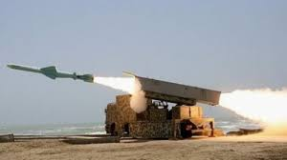




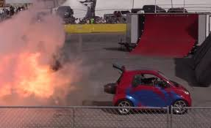
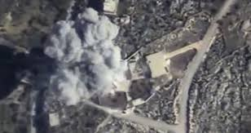

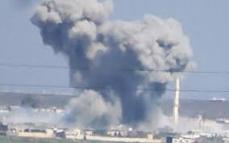
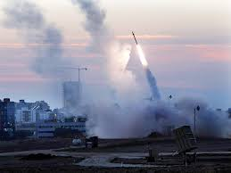
What are we trying to do?
Incident
Today
Detecting Ceasefire Violations
Why do you say that?
What is the evidence?
Could it have been an accident?
I don’t know if this should be reported or not
Learning
Process
This incident is a violation
(p = .93)
Video &
Social Media
Learned
Function
Output
What should I report?
Incident
Tomorrow
Detecting Ceasefire Violations
New
Learning
Process
This is a violation:
I understand why
I understand the evidence for this recommendation
This is clearly one to investigate
These events occur
before tweet reports
Video &
Social Media
Explainable Model
Explanation Interface
What should I report?

Slide 6
Goal: Performance and Explainability
XAI will create a suite of machine learning techniques that
Produce more explainable models, while maintaining a high level of learning performance (e.g., prediction accuracy)
Enable human users to understand, appropriately trust, and effectively manage the emerging generation of artificially intelligent partners
Performance vs. Explainability
Tomorrow
Today
Learning Performance
Explainability (notional)

Slide 7
Measuring Explanation Effectiveness
Measure of Explanation Effectiveness
User Satisfaction
Clarity of the explanation (user rating) Utility of the explanation (user rating)
Mental Model
Understanding individual decisions Understanding the overall model Strength/weakness assessment ‘What will it do’ prediction ‘How do I intervene’ prediction
Task Performance
Does the explanation improve the user’s decision, task performance? Artificial decision tasks introduced to diagnose the user’s understanding
Trust Assessment
Appropriate future use and trust
Correctability (Extra Credit)
Identifying errors Correcting errors Continuous training
Explanation Framework
Task
Recommendation,
Decision or
Action
Explainable Model
Explanation Interface
Decision
The user makes a decision based on the explanation
XAI System
Explanation
The system takes input from the current task and makes a recommendation, decision, or action
The system provides an explanation to the user that justifies its recommendation, decision, or action

Slide 8
Performance vs. Explainability
Learning Techniques (today)
Explainability
(notional)
Neural Nets
Graphical
Models
Deep
Learning
Ensemble
Methods
Bayesian
Belief Nets
Learning Performance
SRL
Random
Forests
AOGs
CRFs
HBNs
Statistical
Models
MLNs
Decision
Trees
Markov Models
SVMs
Explainability

Slide 9
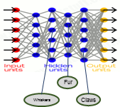
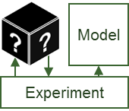
Performance vs. Explainability
New
Approach
Learning Techniques (today)
Explainability
(notional)
Neural Nets
Create a suite of machine learning techniques that
produce more explainable models, while maintaining a high level of learning performance
Graphical
Models
Deep
Learning
Ensemble
Methods
Bayesian
Belief Nets
Learning Performance
SRL
Random
Forests
AOGs
CRFs
HBNs
Statistical
Models
MLNs
Decision
Trees
Markov Models
SVMs
Explainability
Deep Explanation
Modified deep learning techniques to learn explainable features
Interpretable Models
Techniques to learn more structured, interpretable, causal models
Model Induction
Techniques to infer an explainable model from any model as a black box

Slide 10
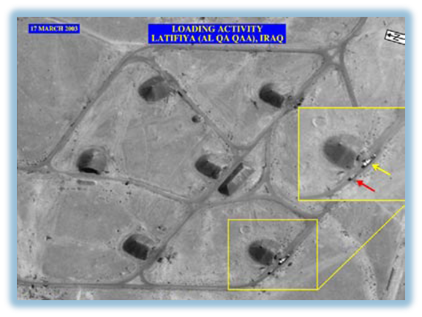

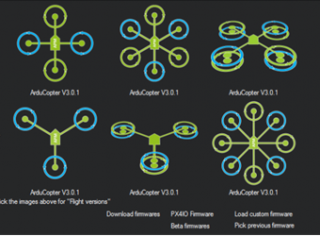

Challenge Problems
Learn a
model
Explain decisions
Use the explanation
Data Analytics
Classification Learning Task
Two trucks performing a loading activity
An analyst is looking for items of interest in massive multimedia data sets
Explainable Model
Explainable
Model
Explanation Interface
Recommend
Explanation
©Getty Images
©Air Force Research Lab
Multimedia Data
Classifies items of interest in large data set
Explains why/why not for recommended items
Analyst decides which items to report, pursue
An operator is directing autonomous systems to accomplish a series of missions
Autonomy
Reinforcement Learning Task
Explainable Model
Explanation Interface
Actions
Explanation
©ArduPikot.org
©US Army
ArduPilot & SITL Simulation
Learns decision policies for simulated missions
Explains behavior in an after-action review
Operator decides which future tasks to delegate

Slide 11

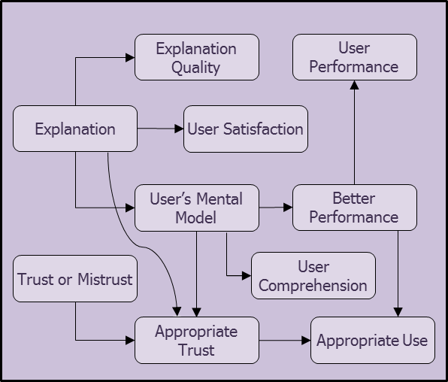


XAI Concept and Technical Approaches
http://www.zerohedge.com/
©2009-2017 ZeroHedge.com/ABC Media, LTD
© 2012, Lost Tribe Media, Inc.
© Toronto Star Newspapers Ltd. 1996–2017
© Associated Newspapers Ltd
© 2017 Hürriyet Daily News
© 2017 Green Car Reports
© 2017 POLITI.TV
© 2017 Business Insider Inc.
© UNHCR 2001-2017
© 2017 Route 66 News
New
Learning
Process
Explainable Model
Explanation Interface
Training Data
UC Berkeley | Deep Learning | Reflexive and Rational
Charles River | Causal Model Induction | Narrative Generation
UCLA | Pattern Theory+ | 3-Level Explanation
OSU | Adaptive Programs | Acceptance Testing
PARC | Cognitive Modeling | Interactive Training
CMU | Explainable RL (XRL) | XRL Interaction
SRI | Deep Learning | Show-And-Tell Explanations
Raytheon | Deep Learning | Argumentation & Pedagogy
UT Dallas | Probabilistic Logic | Decision Diagrams
Texas A&M | Mimic Learning | Interactive Visualization
Rutgers | Model Induction | Bayesian Teaching
IHMC
Psychological Model of Explanation
Approved for public release: distribution unlimited.

Slide 12
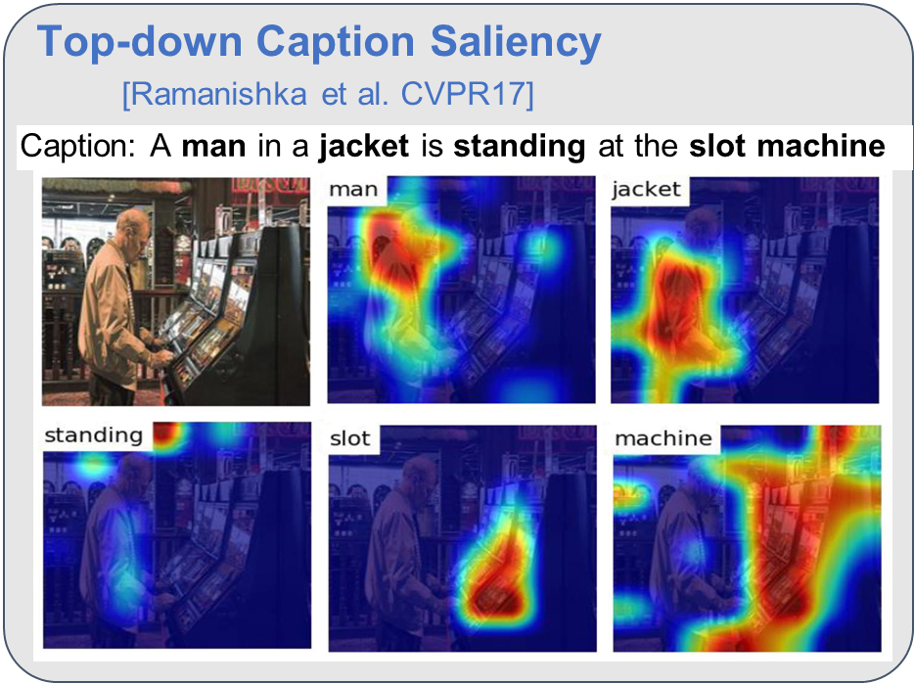
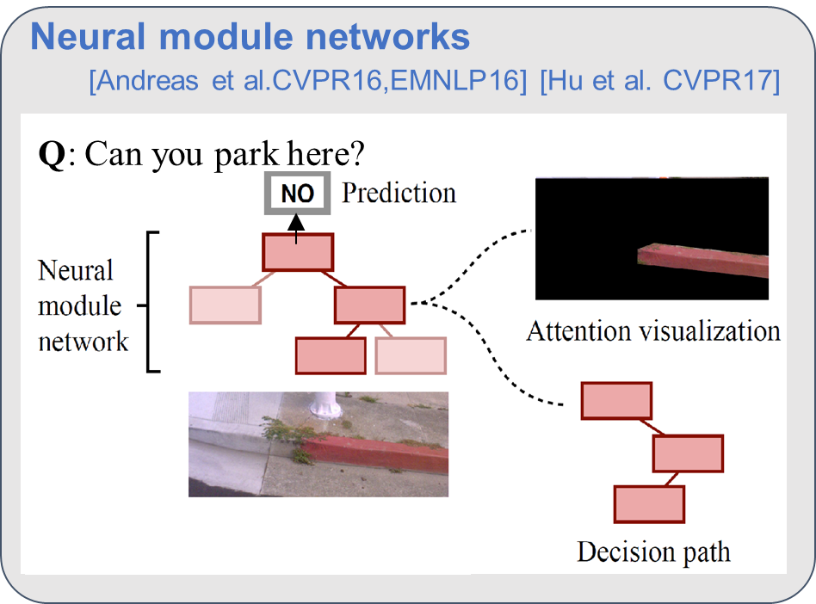
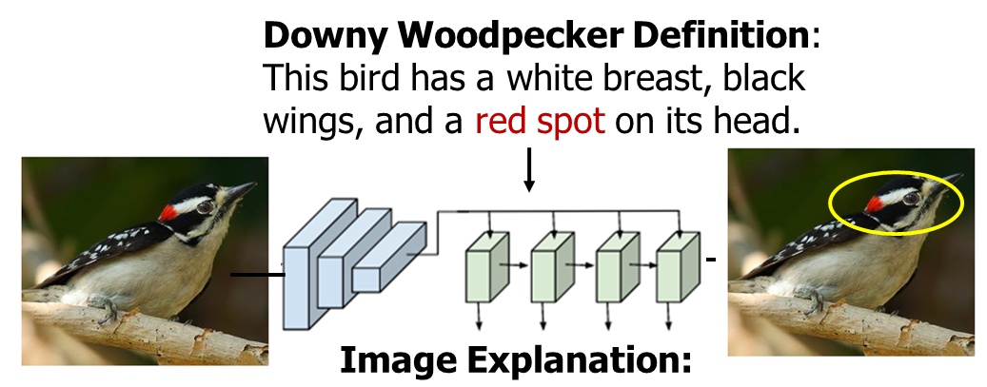
Approaches to Deep Explanation (Berkeley, SRI, BBN, OSU, CRA, PARC)
Attention Mechanisms
Modular Networks
Feature Identification
Learn to Explain
CNN
RNN
This is a Downy Woodpecker because it is a black and white bird with a red spot on its crown.

Slide 13
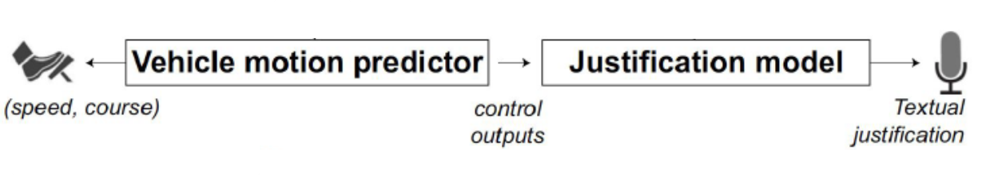
Deeply Explainable AI for Self-driving Vehicles
UC Berkeley
Textual justification system embedded into refined visual attention models to provide appropriate explanation of the behavior of a deep neural vehicle controller
Input Images
Attention Heat Maps
Refined Maps of Visual Saliency
Vehicle controller
Explanation generator
Acceleration, change of course
Textual descriptions + explanations
Examples of Action Description and Justification
Without explanation: “The car heads down the street”
With explanation: “The car heads down the street because there are no other cars in its lane and there are no red lights or stop signs”
Action Description | Action Justification
The car accelerates | because the light has turned green
The car accelerates slowly | because the light has turned green and traffic is flowing
The car is driving forward | as traffic flows freely
The car merges into the left lane | to get around a slower car in front of it
Refined heat maps produce more succinct visual explanations and more accurately expose the network’s behavior
Textual action description and justification provides an easy-to-interpret system for self-driving cars
Kim, Rohrbach, Darrell, Canny, and Akata. Show, Attend, Control, and Justify: Interpretable Learning for Self-Driving Cars
Kim and Canny. Interpretable Learning for Self-Driving Cars by Visualizing Causal Attention
Notes:
Kim, Rohrbach, Darrell, Canny, and Akata. Show, Attend, Control, and Justify: Interpretable Learning for Self-Driving Cars, Interpretable ML Symposium (NIPS 2017), Long Beach, CA.
Deep neural perception and control networks have become key components of self-driving vehicles. User acceptance is likely to benefit from easy-to-interpret visual and textual driving rationales which allow end-users to understand what triggered a particular behavior. Our approach involves two stages. In the first stage, we use visual (spatial) attention model to train a convolutional network end-to-end from images to steering angle commands. The attention model identifies image regions that potentially influence the network’s output. We then apply a causal filtering step to determine which input regions causally influence the vehicle’s control signal. In the second stage, we use a video-to-text language model to produce textual rationales that justify the model’s decision. The explanation generator uses a spatiotemporal attention mechanism, which is encouraged to match the controller’s attention.
We show that visual attention heat maps are suitable “explanations” for the behavior of a deep neural vehicle controller, and do not degrade control accuracy.
We also show that attention maps comprise “blobs” that can be segmented and filtered to produce simpler and more accurate maps of visual saliency.
We introduce a justification system that can be embedded into visual attention model and that can provide appropriate justification of the behavior of a deep neural vehicle controller.

Slide 14
Explanation-Informed Acceptance Testing of Deep Adaptive Programs (xACT), Oregon State University
New perturbation-based technique for generating high-quality saliency maps to support visual explanation of deep RL agents (Atari Breakout Example)
Visualizing Strong Agent Policy
(Tunneling Strategy)
Visualizing Agent Learning
Untrained Agent
Fully-trained Agent
Learning what features are important
Agent has not initiated tunneling strategy and the value network is relatively inactive
(+20 frames) Value network starts attending to far left region of brick wall, and continues to do so for next 70 frames
Learning a tunneling strategy
Visualizing Overfit Agents
Which agent has a more robust strategy?
Saliency maps helped users improve ability to reason about agents
 | Overfit Agent | Control Agent
Without Saliency | 48.4 | 35.5
With Saliency | 25.8 | 58.1
Hint Pixels
added to encourage overfitting
What piece of visual information does each agent primarily use to make its decisions?
 | Overfit Agent | Control Agent
Without Saliency | 67.7% (ball) | 41.9% (ball)
With Saliency | 67.7% (hint pixels) | 32.3% (ball)
Greydanus, Koul, Dodge, and Fern. Visualizing and Understanding Atari Agents
Control Agent
Overfit Agent
Notes:
Visualizing and Understanding Atari Agents
Goal: understand deep RL agents in terms of the information they use to make decisions and the relative importance of visual features.
Deep reinforcement learning (deep RL) agents have achieved remarkable success in a broad range of game-playing and continuous control tasks. While these agents are effective at maximizing rewards, it is often unclear what strategies they use to do so. In this paper, we take a step toward explaining deep RL agents through a case study in three Atari 2600 environments. In particular, we focus on understanding agents in terms of their visual attentional patterns during decision making. To this end, we introduce a method for generating rich saliency maps and use it to explain 1) what strong agents attend to 2) whether agents are making decisions for the right or wrong reasons, and 3) how agents evolve during the learning phase. We also test our method on non-expert human subjects and find that it improves their ability to reason about these agents. Our techniques are general and, though we focus on
Atari, our long-term objective is to produce tools that explain any deep RL policy.
Visualizing deep RL policies for explanation purposes is difficult. Past methods include t-SNE embeddings [15, 25], Jacobian saliency maps [24, 25], and reward curves [15]. These tools generally sacrifice interpretability for explanatory power or vice versa.
For the sake of thoroughness, we limit our experiments to three Atari 2600 environments: Pong, Space Invaders, and Breakout. Our long-term goal is to visualize and understand the policies of any deep reinforcement learning agent that uses visual inputs.
The strong Breakout policy. Previous works have noted that strong Breakout agents often develop tunneling strategies [15, 25]. During tunneling, an agent repeatedly directs the ball at a region of the brick wall in order to tunnel through it. The strategy is desirable because it allows the agent to obtain dense rewards by bouncing the ball between the ceiling and the top of the brick wall. Our impression was that possible tunneling locations would become (and remain) salient from early in the game. Instead, we found that the agent enters and exits a "tunneling mode" over the course of a single frame. Once the tunneling location became salient, it remained so until the tunnel was finished. In the top frame of Figure 2c, the agent has not yet initiated a tunneling strategy and the value network is relatively inactive. Just 20 frames later, the value network starts attending to the far left region of the brick wall, and continues to do so for the next 70 frames (lower frame).
During learning, deep RL agents are known to transition through broad spectrum of strategies. Some of these strategies are eventually discarded in favor of better ones. Does an analogous process occur in Atari agents? We explored this question by saving several models during training and visualizing them with our saliency method. Each row corresponds to a selected frame from a game played by a fully-trained agent. Leftmost agents are untrained, rightmost agents are fully-trained. Each column is separated by ten million frames of training. White arrows denote motion of the ball. The critic appears to learn about the value of tunneling the ball through the bricks as depicted by the clear focus on the tunnel in the upper left part of the screen.
“Overfit", refers to a policy that obtains high rewards, but "for the wrong reasons". Encouraged overfitting by adding "hint pixels" to the raw Atari frames. For "hints" we chose the most probable action selected by a strong ("expert") agent and coded this information as a one-hot distribution of pixel intensities at the top of each frame. With these modifications, we trained overfit agents to predict the expert’s policy in a supervised manner. We trained "control" agents in the same manner, assigning random values to their hint pixels. We expected that the overfit agents would learn to focus on the hint pixels, whereas the control agents would need to attend to relevant features of the game space. We halted training after 3 x106 frames, at which point all agents obtained mean episode rewards at or above human baselines. We were unable to distinguish the overfit agents from the control agents by observing their behavior.
First, participants watched videos of two agents (one control and one overfit) playing Breakout without saliency maps. The policies appear nearly identical in these clips. Next, participants watched the same videos with saliency maps. After each pair of videos, they were instructed to answer several multiple-choice questions. Table: saliency maps helped participants judge whether or not the agent was using a robust strategy. In free response, participants generally indicated that they had switched their choice of "most robust agent" to Agent 2 (control agent) after seeing that Agent 1 (the overfit agent) attended primarily to "the green dots.“ Another question we asked was "What piece of visual information do you think Agent X primarily uses to make its decisions?". Without the saliency videos, respondents mainly identified the ball (Agent 1: 67.7%, Agent 2: 41.9%). With saliencies, most respondents said Agent 1 was attending to the hint pixels (67.7%) and Agent 2 was attending to the ball (32.3%).
Perturbative-based saliency methods. The idea behind perturbative methods is to measure how a model’s output changes when some of the input information is removed.
In this paper, we addressed the growing need for human-interpretable explanations of deep RL agents by introducing a new saliency method and using it to visualize and understand Atari agents. We found that our saliency method can yield effective visualizations for a variety of Atari agents. We also found that these visualizations can help non-experts understand what deep RL agents are doing. Finally, we obtained preliminary results for the role of memory in these policies. Understanding deep RL agents is difficult because they are black boxes that can learn nuanced and unexpected strategies. To produce explanations that satisfy human users, researchers will need to use not one, but many techniques for extracting the "how" and "why" from these agents. This work compliments previous efforts, taking the field a step closer to producing truly satisfying explanations.
Blue = saliency for the actor
Red = saliency for the critic

Slide 15
Network Dissection Quantifying Interpretability of Deep Representations (MIT)
Audit trail: for a particular output unit, the drawing shows the most strongly activated path
Interpretation of several units in pool5 of AlexNet trained for place recognition

Slide 16
Four Modes of Explanation (BBN)
Explanation Modes
Analytic (didactic) statements
in natural language that describe the elements and context that support a choice
Visualizations
that directly highlight portions of the raw data that support a choice and allow viewers to form their own perceptual understanding
Cases
that invoke specific examples or stories that support the choice
Rejections of alternative choices
(or “common misconceptions” in pedagogy) that argue against less preferred answers based on analytics, cases, and data

Slide 17
IHMC/MacroCognition/Michigan Tech Psychological Models of Explanation
Model of the Explanation Process and Possible Metrics
XAI Process
System
XAI Metrics
User
receives
Explanation
revises
User’s Mental Model
enables
Better Performance
may initially
is assessed by
is assessed by
is assessed by
“Goodness” Criteria
Test of Satisfaction
Test of Comprehension
Test of Performance
can engender
involves
Trust or Mistrust
gives way to
Appropriate Trust
enables
Appropriate Use

Slide 18


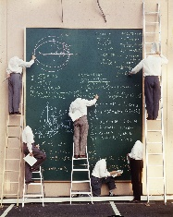



















XAI In the News
Inside DARPA’s Push to Make Artificial Intelligence Explain Itself
Sara Castellanos and Steven Norton
August 10, 2017
Can A.I. Be Taught to Explain Itself?
Cliff Kuang
November 21, 2017
The Dark Secret at the Heart of AI
Will Knight
April 11, 2017
Intelligent Machines Are Asked to Explain How Their Minds Work
Richard Waters
July 11, 2017
You better explain yourself, mister: DARPA's mission to make an accountable AI
Dan Robinson
September 29, 2017
Charles River Analytics-Led Team Gets DARPA Contract to Support Artificial Intelligence Program
Ramona Adams
June 13, 2017
Team investigates artificial intelligence, machine learning in DARPA project
Lisa Daigle
June 14, 2017
Elon Musk and Mark Zuckerberg Are Arguing About AI -- But They're Both Missing the Point
Artur Kiulian
July 28, 2017
Why The Military And Corporate America Want To Make AI Explain Itself
Steven Melendez
June 22, 2017
Ghosts in the Machine
Christina Couch
October 25, 2017
Oracle quietly researching 'Explainable AI‘
George Nott
May 5, 2017
How AI detectives are cracking open the black box of deep learning
Paul Voosen
July 6, 2017
DARPA’s XAI seeks explanations from autonomous systems
Geoff Fein
November 16, 2017
Demystifying the Black Box That Is AI
Ariel Bleicher
August 9, 2017
Notes:
Adams, Ramona. “Charles River Analytics-Led Team Gets DARPA Contract to Support Artificial Intelligence Program” ExecutiveBiz, 13 Jun. 2017, http://blog.executivebiz.com/2017/06/charles-river-analytics-led-team-gets-darpa-contract-to-support-artificial-intelligence-program/.
Baum, Stephanie. "DARPA researchers want to know how and why machine learning algorithms get it wrong." MedCityNews, 12 Aug. 2017, https://medcitynews.com/2017/08/darpa-researchers-want-know-machine-learning-algorithms-get-wrong/.
Bleicher, Ariel. "Demystifying the Black Box That Is AI." Scientific Amerian, 9 Aug. 2017, https://www.scientificamerican.com/article/demystifying-the-black-box-that-is-ai/.
Castellanos, Sara, and Norton, Steve. "Inside Darpa’s Push to Make Artificial Intelligence Explain Itself." The Wall Street Journal, 10 Aug. 2017, https://blogs.wsj.com/cio/2017/08/10/inside-darpas-push-to-make-artificial-intelligence-explain-itself/.
Couch, Christina. "Ghosts in the Machine." Nova Next, 25 Oct. 2017, http://www.pbs.org/wgbh/nova/next/tech/ai-bias/?utm_source=TWITTER&utm_medium=social&utm_term=20171025&utm_content=1126649965&linkId=43924702.
Daigle, Lisa. "Team investigates artificial intelligence, machine learning in DARPA project." Military Embedded Systems, 14 Jun. 2017, http://mil-embedded.com/news/team-investigates-artificial-intelligence-machine-learning-in-darpa-project/#.
Fein, Geoff. "DARPA’s XAI seeks explanations from autonomous systems." IHS Jane's International Defence Review, 16 Nov. 2017, http://www.janes.com/article/75754/darpa-s-xai-seeks-explanations-from-autonomous-systems.
Kiulian, Artur. "Elon Musk and Mark Zuckerberg Are Arguing About AI -- But They're Both Missing the Point." Entrepreneur, 28 Jul. 2017, https://www.entrepreneur.com/article/297861.
Knight, Will. "The Dark Secret at the Heart of AI." MIT Technology Review, 11 Apr. 2017, https://www.technologyreview.com/s/604087/the-dark-secret-at-the-heart-of-ai/.
Kuang, Cliff. "Can A.I. Be Taught to Explain Itself?" The New York Times Magazine, 21 Nov. 2017, https://www.nytimes.com/2017/11/21/magazine/can-ai-be-taught-to-explain-itself.htm.
LeVine, Steve. "The battle behind making machines more human-like." Axios, 30 Jun. 2017, https://www.axios.com/the-debate-over-whether-machines-should-defend-their-opinions-2450637388.html.
Melendez, Steven. "Why The Military And Corporate America Want To Make AI Explain Itself." Fast Company, 22 Jun. 2017, https://www.fastcompany.com/40433959/why-the-military-and-corporate-america-want-to-make-ai-explain-itself.
Nott, George. "Oracle quietly researching 'Explainable AI'." Computerworld Austrailia, 5 May. 2017, https://www.computerworld.com.au/article/618770/oracle-quietly-researching-explainable-ai/.
Robinson, Dan. "You better explain yourself, mister: DARPA's mission to make an accountable AI." The Register, 28 Sep. 2017, https://www.theregister.co.uk/2017/09/28/inside_explainable_ai/.
"The Morning Download: Darpa Orchestrates Effort to Make AI Explain Itself." The Wall Street Journal, 11 Aug. 2017, https://blogs.wsj.com/cio/2017/08/11/the-morning-download-darpa-orchestrates-effort-to-make-ai-explain-itself/.
Waters, Richard. "Intelligent machines are asked to explain how their minds work." Financial Times, 9 Jul. 2017, https://www.ft.com/content/92e3f296-646c-11e7-8526-7b38dcaef614.

